Slide 1
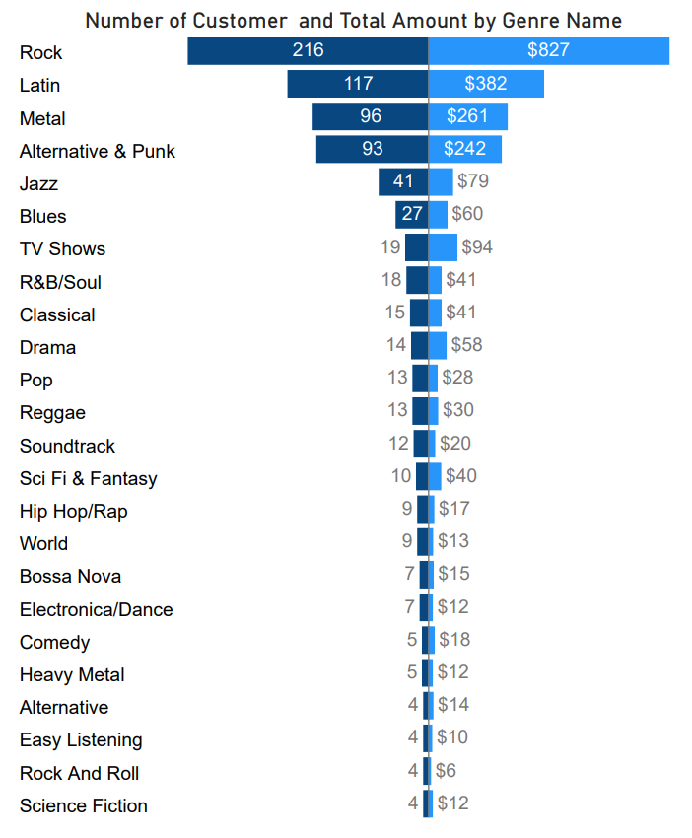
What is Total sales and number of customers for each Genre of track ?
The number of customers for the track Genre reached about 216 and spent about 827 (total sales), which is considered the most sales and audiences.

Slide 2
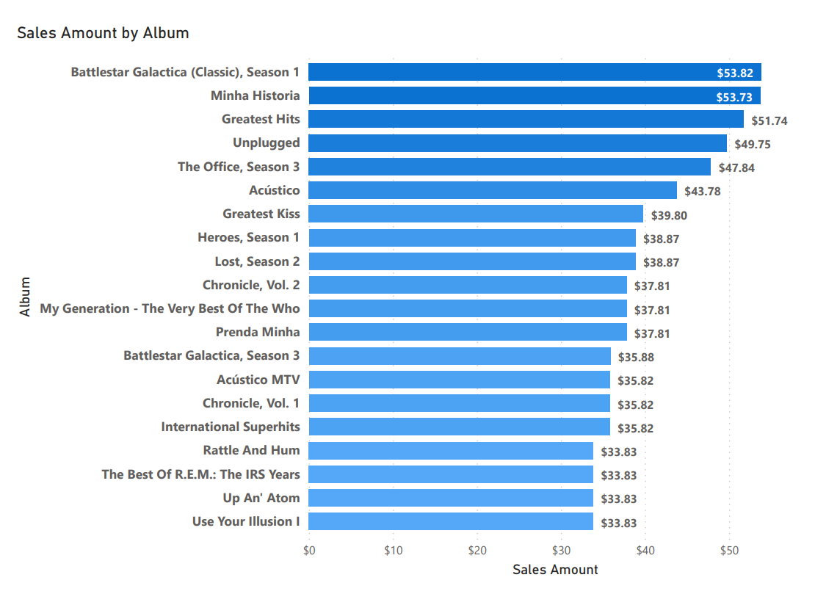
What are sales some of album's Track ?
The most sold album is “ Battelstar galactica (classic),season 1 “ with a total of 53.82 dollars, which is approximately equal to ” Minha Historia “ with a value of 53.73 dollars.

Slide 3
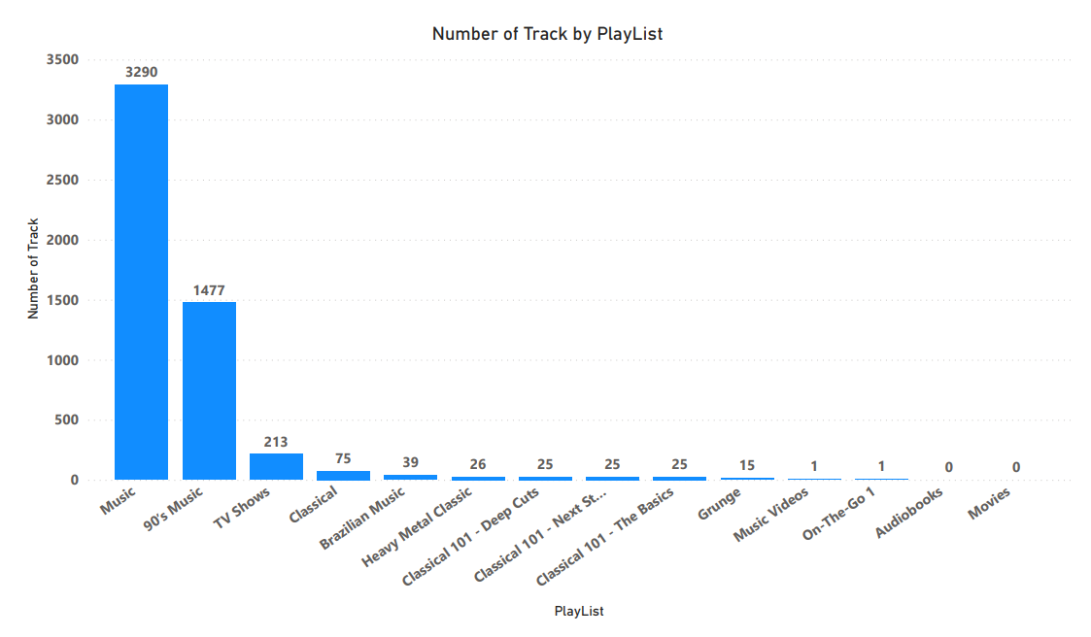
How many songs are in each playlist ?
In the forefront is music with 3,290 Tracks, and then 90's music, note that there are no Movies and Audiobooks Since there are no Tracks in it .

Slide 4
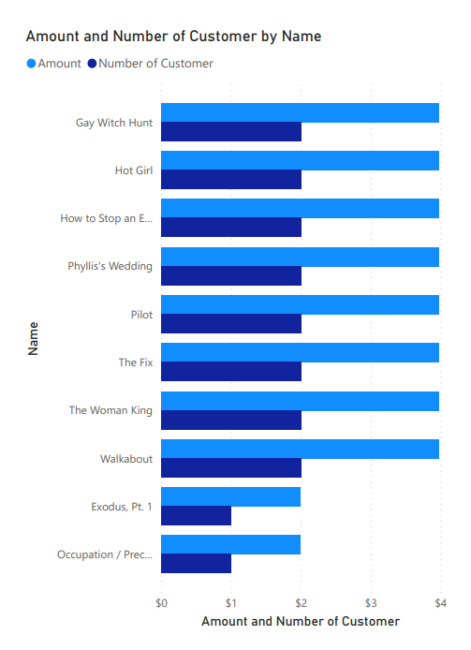
What are the top 10 sales Track and the number of customers for each of them?
The first 8 track are equal in sales, where the sales of each one are approximately $4, also the number of customers is equal to 2 .

